Slide 1

STATS 432 Computational Statistics
Tutorial 1 – Permutation Testing (Part I)

Slide 2

Question 1

Slide 3
Question 1:
Question 1
A researcher is interested in whether alcohol consumption affects the level of the chemical secretin produced by the pancreas.
He takes a random sample of 300 study participants and classifies them as ‘Non-Drinkers’, ‘Moderate Drinkers’ or ‘Heavy Drinkers’ based on their weekly alcohol consumption. 100 study participants are assigned to each group. The level of secretin (in mgs) produced by each study participant over the course of 1 hour is then measured. The results of this process are recorded in the data set entitled ‘Secretin.csv’.
Testing Normality
Read the data into R and create a histogram of the data in each group.
Create a linear model, modelling secretin production as a function of alcohol consumption. Construct a QQ-Plot of the residuals of this model. What does this tell us about whether the data in each group is normally distributed?
Conduct a Shapiro-Wilks test on the residuals of the linear model. What do you conclude?
Testing Homogeneity of Variance
Construct a box plot of the data from each group.
Construct a residual-vs-fitted value plot using the output of the model constructed in part b). What does this tell you as to whether the data in each group arises from distributions with the same variance?
Conduct a Levene’s test to test whether the data in each group arises from distributions with the same variance? What do you conclude?
One Way ANOVA
Given that the conditions of one-way ANOVA are satisfied, test whether the mean level of secretin produced by study participants in each group is the same. Specify the hypotheses being tested, the F-statistic, degrees of freedom, p-value and conclusion you reach.
3

Slide 4
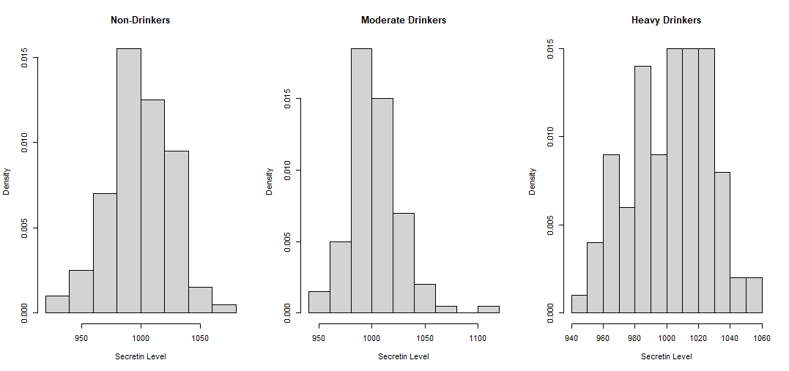
Question 1:
Question 1
Read the data into R and create a histogram of the data in each group.
See Section 1.1a of the code
4
Associated code = Tutorial 1 – Q1

Slide 5
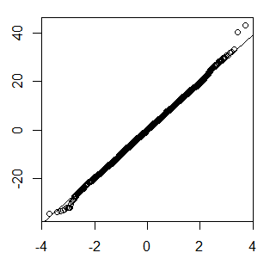
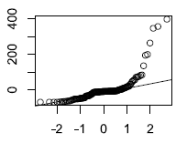
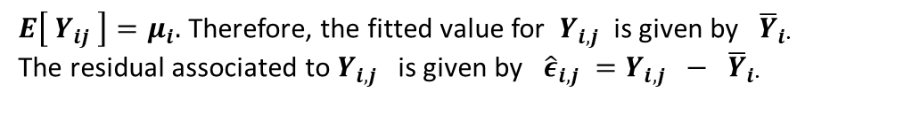



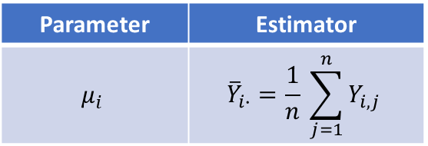
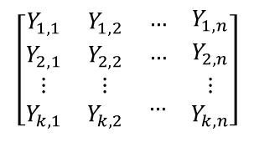
What do QQ-Plots Show?
Question 1
In one-way ANOVA we fit the model…
$$\left[\begin{matrix}Y_{1,1} & Y_{1,2} & \begin{matrix}… & Y_{1,n}\end{matrix} \\ Y_{2,1} & Y_{2,2} & \begin{matrix}… & Y_{2,n}\end{matrix} \\ \begin{matrix}⋮ \\ Y_{k,1}\end{matrix} & \begin{matrix}⋮ \\ Y_{k,2}\end{matrix} & \begin{matrix}… & \begin{matrix}⋮ \\ Y_{k,n}\end{matrix}\end{matrix}\end{matrix}\right]$$
Parameter | Estimator
$$μ_{i}$$ | $${\overline{Y}}_{i∙}=\frac{1}{n} \sum_{j=1}^{n}{Y_{i,j}}$$
$$Y_{i,j} = μ + α_{i} + ε_{i,j} ≡ μ_{i} + ε_{i,j}$$
$$ε_{i,j} \sim N(0, σ^{2})$$
$E\left[ Y_{ij} \right]=μ_{i}.$ Therefore, the fitted value for $Y_{i,j}$ is given by ${\overline{Y}}_{i∙}$
The residual associated to $Y_{i,j}$ is given by ${\hat{ε}}_{i,j} =Y_{i,j} − {\overline{Y}}_{i∙}$
$$↔$$
Note if $Y_{i,j} \sim N\left( μ_{i} , σ^{2}\right)$ ${\hat{ε}}_{i,j} =Y_{i,j} − {\overline{Y}}_{i∙} \sim N\left( 0, σ^{2}\right)$
To show that the data in each group is normally distributed, it suffices to show that residuals are normally distributed.
Normal QQ-plots plot the percentiles of your data (or residuals of your data) against the percentiles of the standard normal distribution. If the QQ-plot follows a straight line, this suggest that your data (or residuals of your data) are normally distributed.
If the QQ-plot does not follow a straight line, this suggests that your data (or the residuals of your data) are not normally distributed.
QQ-Plot of residuals vs standard normal suggests data is normally distributed
QQ-Plot of residuals vs standard normal suggests data is not normally distributed
Sample Quartiles
Sample Quartiles
Theoretical Quartiles
Theoretical Quartiles
5
Associated code = Tutorial 1 – Q1

Slide 6
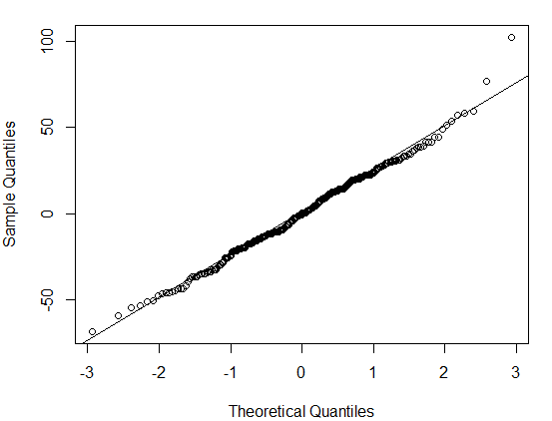
Question 1:
Question 1
Create a linear model, modelling secretin production as a function of alcohol consumption. Construct a QQ-Plot of the residuals of this model. What does this tell us about whether the data in each group is normally distributed?
Conduct a Shapiro-Wilks test on the residuals of the linear model. What do you conclude?
See Section 1.1c of the code
See Section 1.1b of the code
Shapiro-Wilks tests is designed to test between the following null and alternative hypotheses… H0: Data is normally distributed H1: Data is not normally distributed
In this case the Shapiro-Wilks test is applied to the residuals of our model and gives the following results… W = 0.99254, p-value = 0.1382
No evidence against the null hypothesis that the residuals of our model are normally distributed.
→ No evidence against the null hypothesis that the data in each group is normally distributed.
Suggests residuals are normally distributed. → Data in each group is normally distributed
6
Associated code = Tutorial 1 – Q1

Slide 7
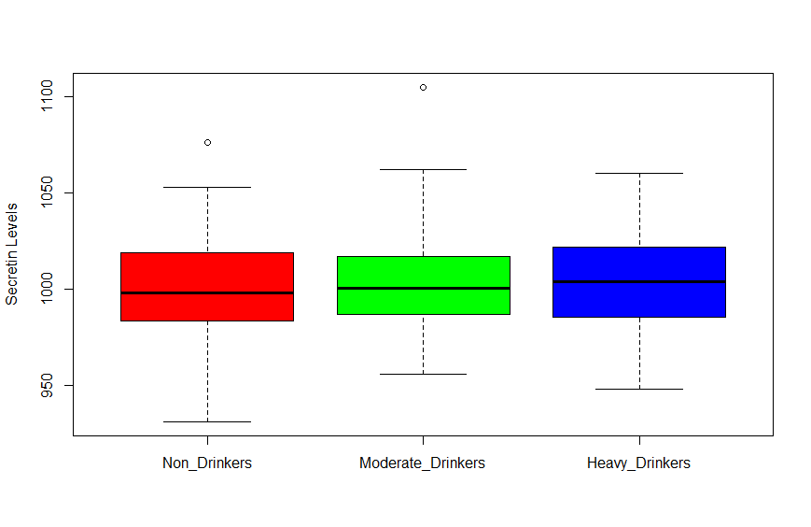
Question 1:
Question 1
Construct a box plot of the data from each group.
See Section 2.1a of the code
7
Associated code = Tutorial 1 – Q1

Slide 8
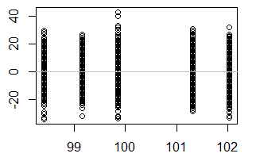
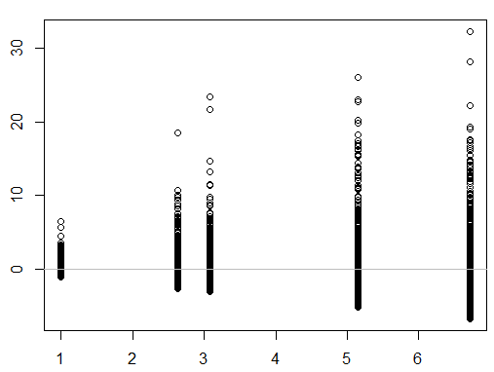
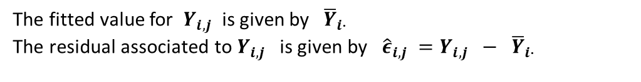
What do Residual-vs-Fitted-Value Plots Show?
Question 1
In one-way ANOVA we fit the model…
$$\left[\begin{matrix}Y_{1,1} & Y_{1,2} & \begin{matrix}… & Y_{1,n}\end{matrix} \\ Y_{2,1} & Y_{2,2} & \begin{matrix}… & Y_{2,n}\end{matrix} \\ \begin{matrix}⋮ \\ Y_{k,1}\end{matrix} & \begin{matrix}⋮ \\ Y_{k,2}\end{matrix} & \begin{matrix}… & \begin{matrix}⋮ \\ Y_{k,n}\end{matrix}\end{matrix}\end{matrix}\right]$$
Parameter | Estimator
$$μ_{i}$$ | $${\overline{Y}}_{i∙}=\frac{1}{n} \sum_{j=1}^{n}{Y_{i,j}}$$
$$Y_{i,j} = μ + α_{i} + ε_{i,j} ≡ μ_{i} + ε_{i,j}$$
$$ε_{i,j} \sim N(0, σ^{2})$$
The fitted value for $Y_{i,j}$ is given by ${\overline{Y}}_{i∙}$
The residual associated to $Y_{i,j}$ is given by ${\hat{ε}}_{i,j} =Y_{i,j} − {\overline{Y}}_{i∙}$
Since $Var\left[ Y_{i,j} \right] = Var[ ε_{i,j} ]$, if the variance of the residuals in each group appears to be different this would suggest that the data in each group arises from populations with different variance.
Since the data in each group is assigned the same fitted value (${\overline{Y}}_{i∙}$) if we were to construct a plot of residuals on the y-axis and fitted values on the x-axis this will result in a series of vertical ‘bands’ visualising the distribution of residuals in each group.
Bands have the same ‘height’ suggests constant variance
Bands with differing ‘heights’ suggests non-constant variance
Residual
Residual
Fitted
Fitted
8

Slide 9
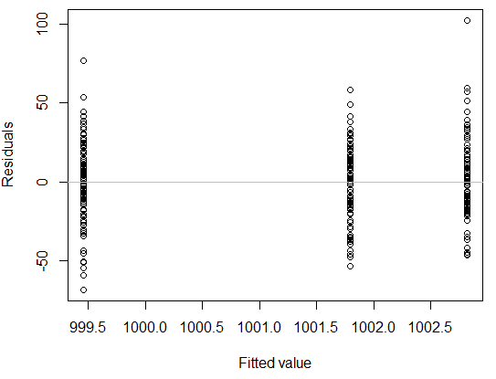
Question 1:
Question 1
Construct a residual-vs-fitted value plot using the output of the model constructed in part b). What does this tell you as to whether the data in each group arises from distributions with the same variance?
Conduct a Levene’s test to test whether the data in each group arises from distributions with the same variance? What do you conclude?
See Section 2.1c of the code
See Section 2.1b of the code
Levene’s tests is designed to test between the following null and alternative hypotheses… H0: Data arise from distributions with the same variance H1: Data arise from distributions with different variances
In this case Levene’s test is applied to the data in each group F = 0.1397, p-value = 0.8697
No evidence against the null hypothesis that the data from each group arise from distributions with the same variance.
Bands roughly the same height → Suggests residuals (and therefore the data) in each group has the same variance
9
Associated code = Tutorial 1 – Q1

Slide 10
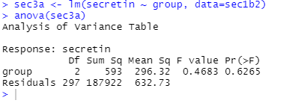
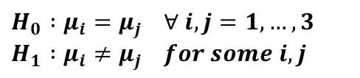
Question 1:
Question 1
Given that the conditions of one-way ANOVA are satisfied, test whether the mean level of secretin produced by study participants in each group is the same. Specify the hypotheses being tested, the F-statistic, degrees of freedom, p-value and conclusion you reach.
See Section 3.1a of the code
$$H_{0} :μ_{i}=μ_{j} ∀ i,j=1,…, 3 \\ H_{1} :μ_{i}≠μ_{j} for some i,j$$
F-Statistic = 0.4683 df = (2, 297)
P-value = 0.625 No evidence against H₀. Conclude that alcohol consumption has no effect on the mean level of secretin produced by the pancreas.
10
Associated code = Tutorial 1 – Q1

Slide 11
Question 2

Slide 12
Question 2:
Question 2
A company is interested in whether the mean hourly number of incoming calls differs across its three call Centres (A, B & C). The company records the number of incoming calls at each Centre over 50 separate 1-hour periods. The data pertaining to this experiment is recorded in the data set called ‘Incoming Calls.csv’ .
Testing Normality
Read the data into R and create a histogram of the data in each group.
Create a linear model, modelling the number of incoming calls as a function of call centre. Construct a QQ-Plot of the residuals of this model. What does this tell us about whether the data in each group is normally distributed?
Conduct a Shapiro-Wilks test on the residuals of the linear model. What do you conclude?
Testing Homogeneity of Variance
Construct a box plot of the data from each group.
Construct a residual-vs-fitted value plot using the output of the model constructed in part b). What does this tell you as to whether the data in each group arises from distributions with the same variance?
Conduct a Levene’s test to test whether the data in each group arises from distributions with the same variance? What do you conclude?
Permutation Test
Given that the conditions of one-way ANOVA are violated, conduct a permutation test to test whether the mean hourly number of incoming calls is the same across all three call centres. Specify the hypotheses being tested, the p-value of the test and the conclusion you reach.
12

Slide 13
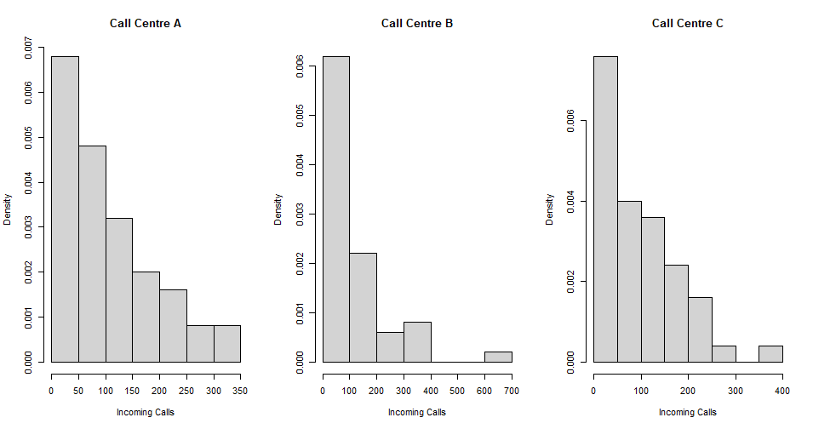
Question 2:
Question 2
Read the data into R and create a histogram of the data in each group.
See Section 1.1a of the code
13
Associated code = Tutorial 1 – Q2

Slide 14
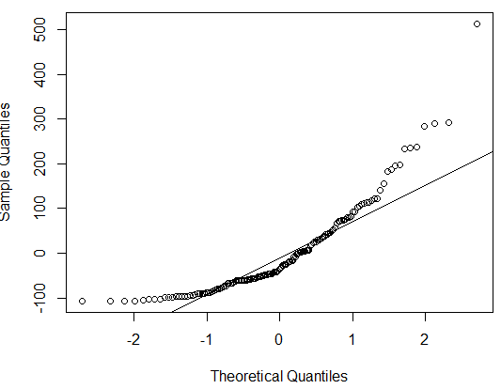
Question 2:
Question 2
Create a linear model, modelling the number of incoming calls as a function of call centre. Construct a QQ-Plot of the residuals of this model. What does this tell us about whether the data in each group is normally distributed?
Conduct a Shapiro-Wilks test on the residuals of the linear model. What do you conclude?
See Section 1.1c of the code
See Section 1.1b of the code
Shapiro-Wilks tests is designed to test between the following null and alternative hypotheses… H0: Data is normally distributed H1: Data is not normally distributed
In this case the Shapiro-Wilks test is applied to the residuals of our model and gives the following results… W = 0.84233, p-value = 2.095e-11
Very strong evidence against the null hypothesis that the residuals of our model are normally distributed.
→ Very strong evidence against the null hypothesis that the data in each group is normally distributed.
Suggests residuals are NOT normally distributed. → Data in each group is NOT normally distributed
14
Associated code = Tutorial 1 – Q2

Slide 15
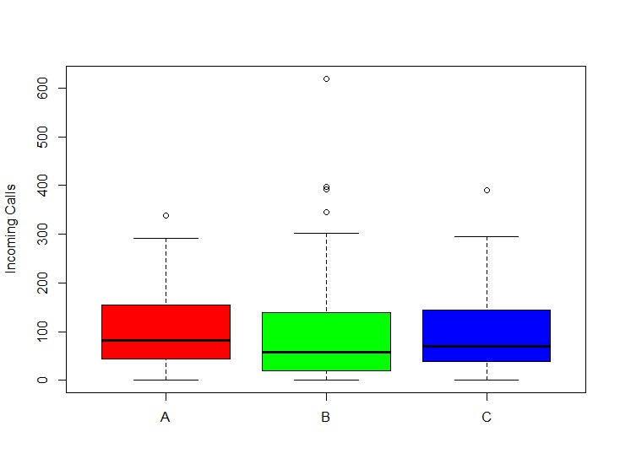
Question 2:
Question 2
Construct a box plot of the data from each group.
See Section 2.1a of the code
15
Associated code = Tutorial 1 – Q2

Slide 16
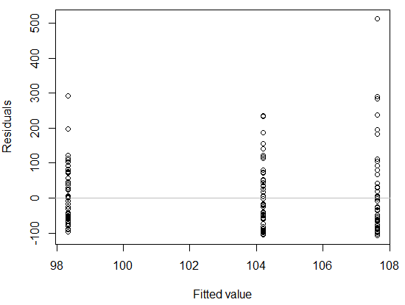
Question 2:
Question 2
Construct a residual-vs-fitted value plot using the output of the model constructed in part b). What does this tell you as to whether the data in each group arises from distributions with the same variance?
Conduct a Levene’s test to test whether the data in each group arises from distributions with the same variance? What do you conclude?
See Section 2.1c of the code
See Section 2.1b of the code
Levene’s tests is designed to test between the following null and alternative hypotheses… H0: Data arise from distributions with the same variance H1: Data arise from distributions with different variances
In this case Levene’s test is applied to the data in each group F = 1.0602, p-value = 0.349
No evidence against the null hypothesis that the data from each group arise from distributions with the same variance.
Bands roughly the same height → Suggests residuals (and therefore the data) in each group has the same variance
16
Associated code = Tutorial 1 – Q2

Slide 17
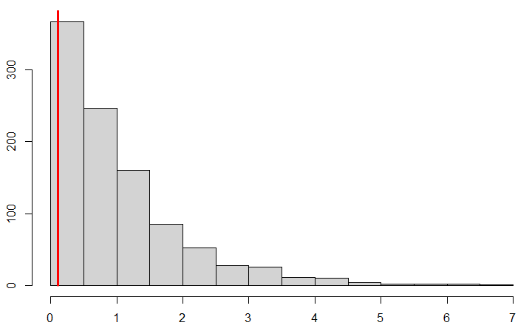
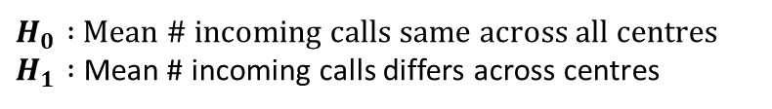
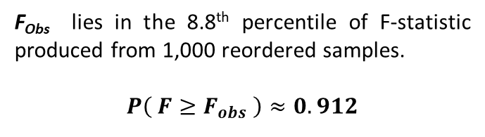
Question 2:
Question 2
Given that the conditions of one-way ANOVA are violated, conduct a permutation test to test whether the mean hourly number of incoming calls is the same across all three call centres. Specify the hypotheses being tested, the p-value of the test and the conclusion you reach.
See Section 3 of the code
Histogram of F-Statistics Produced from 1,000 Reordered Samples
$H_{0} :$ Mean # incoming calls same across all centres $H_{1} :$ Mean # incoming calls differs across centres
F_{obs} = 0.108
F_{Obs} lies in the 8.8th percentile of F-statistic produced from 1,000 reordered samples.
$$P\left( F≥F_{obs} \right)≈0.912$$
Permutation test yields no evidence against H₀. Conclude that there is no difference in the mean hourly number of incoming calls at each call centre.
17
Associated code = Tutorial 1 – Q2

